Slide 1
Aircraft Safety and Accident Analysis: Recommendations for New Acquisitions
Insights on Safety and Risk for Aircraft Purchases
Presented by Louis Ragen (Data Science School Project Phase1)
9th September 2024

Slide 2
Presentation Overview
Content:
Business Problem
Data used in the analysis
Insights from the data used
Recommendations

Slide 3

Business Problem
The business is expanding into the aviation industry and needs to assess potential aircraft risks.
We were tasked with analyzing aviation accident data to determine the safest aircraft for commercial or private use.

Slide 4
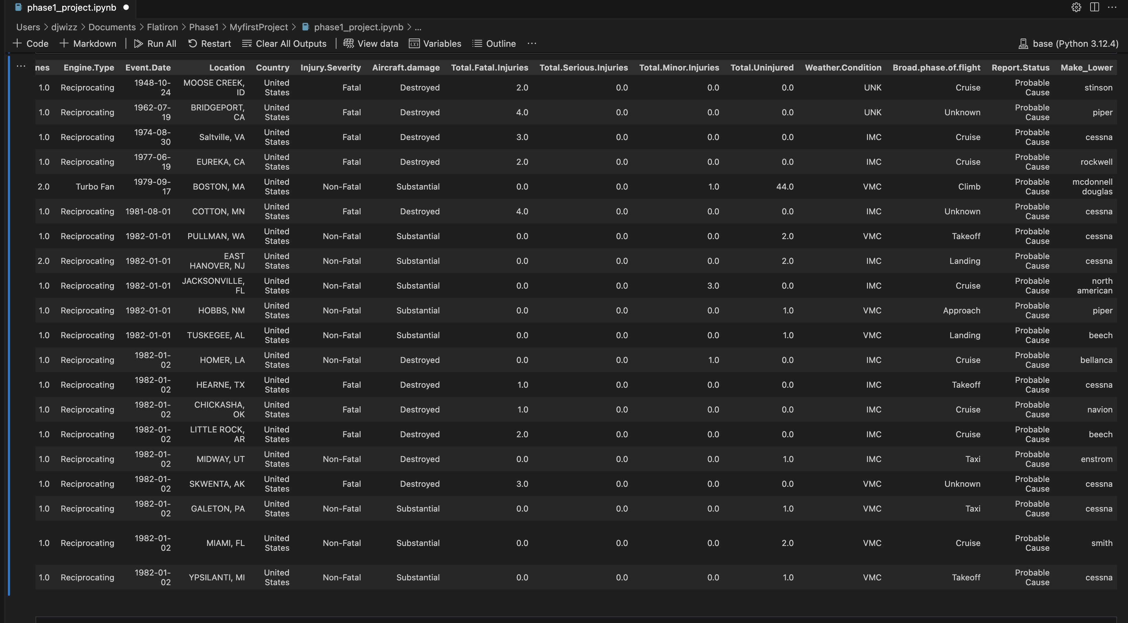
Data used in the analysis
Source: National Transportation Safety Board (NTSB) aviation accident data (1962-2023).
Key Columns used:
Aircraft Make (Make_Lower)
Accident Date (Event.Date)
Weather Conditions (Weather.Condition)
Injury Severity (Injury.Severity)
Aircraft Damage (Aircraft.damage)
Phases of Flight (Broad.phase.of.flight)

Slide 5
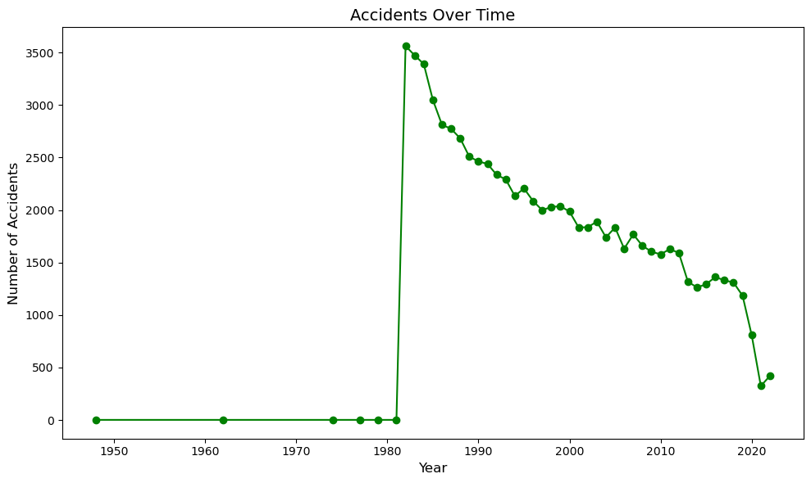
Accidents Over Time: Trends
The line chart shows the number of accidents from 1962 to 2023.
The graph clearly shows that the data was well collected after 1980
There was quite a number of accidents that have significantly reduced over time possibly due to improved safety regulations.

Slide 6
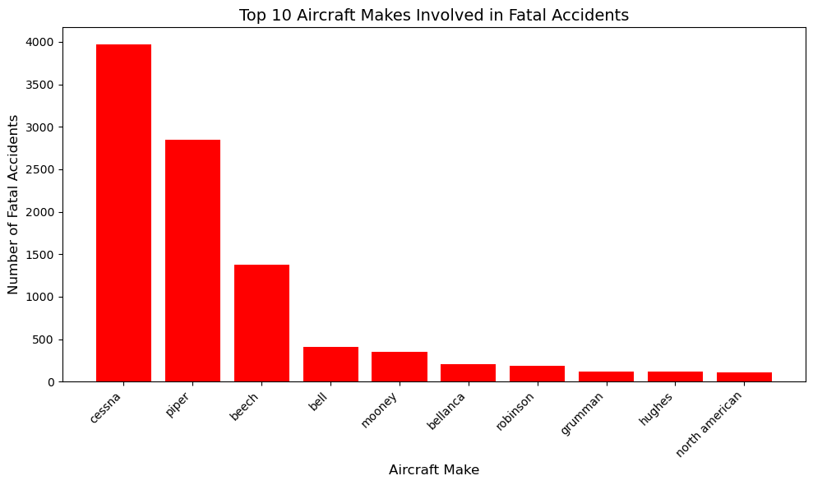
Top Aircraft Makes Involved in Accidents
Cessna, Piper, and Beechcraft have the highest number of accidents in the dataset.
This could be related to their prevalence in the market (e.g., Cessna is one of the most widely produced aircraft).
Cessna and Piper are the most common aircraft in accidents, but this might be due to their large market share.

Slide 7
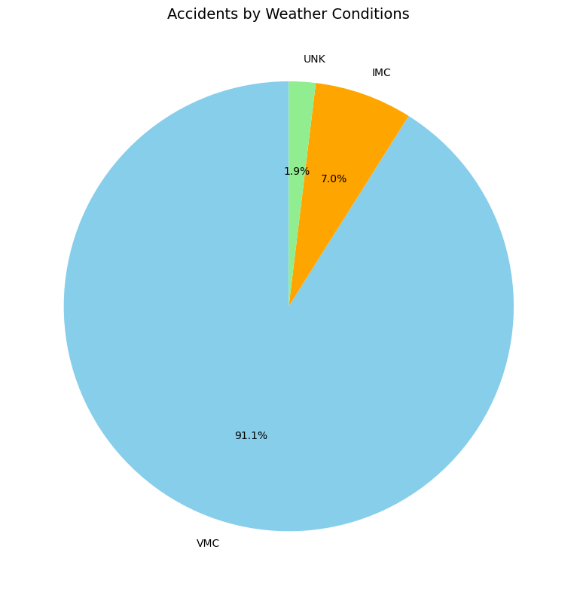
Accidents by Weather Condition
Accidents occur more frequently in Visual Meteorological Conditions (VMC) than in Instrument Meteorological Conditions.
This may be due to increased accuracy of the equipment used hence an overall reduction of accidents over time as technology improves.

Slide 8
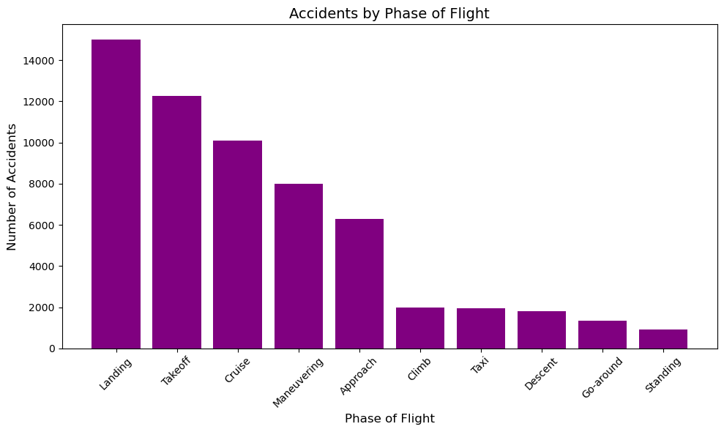
Accidents by Phase of Flight
Landing and Takeoff phases have the highest accident rates.
However, accidents during the En Route phase tend to be more severe, often involving fatalities.

Slide 9
Recommendations for Aircraft Acquisition
Cessna and Piper: Despite their accident rates, these aircraft are widely produced and known for reliability. Consider models with strong safety records. The ratio of units sold to accidents may need to be established before ruling them out.
Avoid Aircraft in Poor Weather: Aircraft operating in IMC conditions need stricter regulations and better training. The business should also research on the routes of operation to have better choice of aircraft to purchase.
Focus on Safe Phases: Ensure operations are in airports with proper air traffic control and wide experience in handling all types of aircrafts.

Slide 10
Next Steps for Business Implementation
Further analysis on specific aircraft makes and models with more detailed safety features. The number of units sold overall would help to get the ratio of accidents to make.
Of the IMC accidents there needs to be a check on weather those models made any changes to their instrumentation to improve on the aircraft performance in harsh weather conditions.
The pilots selection should be very strict and their knowledge of the aircrafts and number of flight hrs experience will need to be heavily scrutinized.

Slide 11
Conclusion
Aircraft Makes: Our analysis revealed that the most common aircraft involved in accidents are Cessna, Piper, and Beechcraft. However, this can be attributed to their larger market share rather than indicating they are inherently unsafe. More focus should be placed on investigating specific models with poor safety records.
Weather Conditions: Accidents predominantly occur in Visual Meteorological Conditions (VMC), largely because flights are more common in these conditions. However, Instrument Meteorological Conditions (IMC) show a higher proportion of fatal accidents, suggesting that adverse weather conditions significantly increase the severity of accidents. This underscores the importance of safety measures in poor weather.
Phases of Flight: The majority of accidents occur during landing and takeoff, which are naturally high-risk phases of flight. Interestingly, accidents occurring en route tend to have more severe outcomes, often involving multiple fatalities. This highlights the need for increased safety measures, particularly during landing and takeoff phases.
Injury Severity and Aircraft Damage: The analysis shows a clear correlation between aircraft damage and injury severity. Aircraft that were destroyed during accidents had a higher likelihood of resulting in fatal outcomes, while those with minor or substantial damage typically resulted in non-fatal injuries. This confirms that the level of damage is a strong indicator of the severity of the accident.

Slide 12
Thank You
Louis Ragen
0721486942
louis.ragen@gmail.com

